Slide 1
AJAX

Slide 2
OVERVIEW
What is AJAX ?
Why AJAX ?
AJAX Vs Classical Web Approach.
How AJAX Works ?
XMLHttpRequest ?
How to make an AJAX application ?
Live AJAX Examples.

Slide 3
WHAT IS AJAX ?
Ajax isn’t a new technology or programming language.
It is a technique used to develop interactive web applications that are able to process a user request immediately.
Ajax can selectively modify a part of a page displayed by the browser, and update it without the need to reload the whole document with all images, menus, etc.

Slide 4
WHAT IS AJAX ?(CONT)
The word "Asynchronous" in AJAX means that the request to the server will be made. The response will be made available by the server after it has finished processing the request, without having to wait for it explicitly, to come back. i.e. you don’t have to wait for an answer.

Slide 5
WHY AJAX?
The common problem is WebPages always “RELOAD” and never get “UPDATED”, creating a break in user interaction.
Users wait for the entire page to load even if a single piece of data is needed
Restriction on single Request/Response.
Need for complicated UI components.

Slide 6
TECHNOLOGIES INVOLVED
JavaScript – for binding everything together.
HTML & Cascading Style Sheets (CSS), for presentation and to provide style classes for the component styling.
XMLHttpRequest – provides asynchronous data retrieval.
Document Object Model (DOM), for dynamic display and interaction and provides a tree structure for the components placed in the web page.
Extensible Markup Language (XML), Format to send data from client to server, though other formats like JSON may also be used.

Slide 7
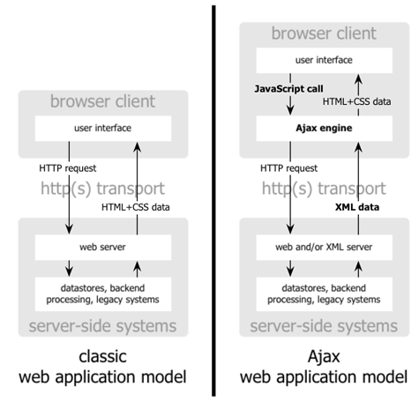
AJAX APPROACH VS CLASSICAL APPROACH
Diagram Reference : www.adaptivepath.com

Slide 8
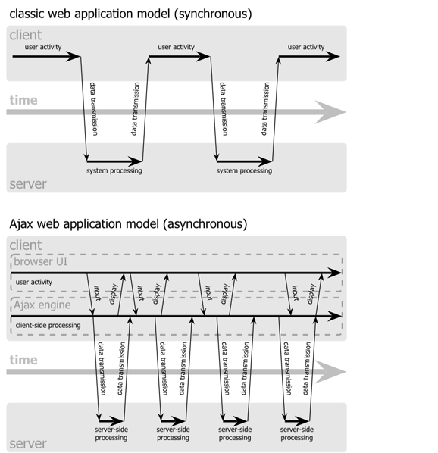
AJAX APPROACH VS CLASSICAL APPROACH (CONT)
Diagram reference:www.adaptivepath.com

Slide 9
HOW AJAX WORKS ?
A JavaScript function creates and configures an XMLHttpRequest object on the client, and specifies a JavaScript callback function.
The XMLHttpRequest object makes an asynchronous call to the web server.
The web server processes the request and returns an XML document that contains the result.
The XMLHttpRequest object calls the callback function and exposes the response from the web server so that the request can be processed.
The client updates the HTML DOM representing the page with the new data.

Slide 10
XMLHTTPREQUEST ?
XMLHttpRequest object is the key to Ajax programming.
It’s main purpose is to put an asynchronous http request to the web server.
Because of this asynchronous call to the web server, you are allowed to continue using the page without the interruption of a browser refresh and the loading of a new or revised page.
This object has few properties.

Slide 11
PROPERTIES OF XMLHTTPREQUEST
Property 1: objXMLHttp.onreadystatechange
This property holds the reference of function which is going to process the response from the server.
objXMLHttp.onreadystatechange = procRequest;
* "procRequest " is the function which will process the response

Slide 12
PROPERTIES OF XMLHTTPREQUEST
Property 2 : objXMLHttp. readyState
This property holds the status of server response.
objXMLHttp.readyState = [state];
State Description
0 | The request is not initialized
1 | The request has been set up
2 | The request has been sent
3 | The request is in process
4 | The request is complete

Slide 13
PROPERTIES OF XMLHTTPREQUEST
Property 3: objXMLHttp.responseText
This property retrieves the data sent back from server.
var objVal = objXMLHttp. responseText;
While the responseText is used to return text ,
responseXML can be used to return an XML document object.
var xmlDoc;
xmlDoc = objXMLHttp.responseXML.documentElement

Slide 14
METHODS OF XMLHTTPREQUEST
XMLHttpRequest.open(method, url[, async])
xhr.open: Initializes a request.
Parameters
Method: The HTTP request method to use, such as "GET", "POST", "PUT", "DELETE", etc. Ignored for non-HTTP(S) URLs.
url:A DOMString representing the URL to send the request to.
async (Optional):An optional Boolean parameter, defaulting to true, indicating whether or not to perform the operation asynchronously.

Slide 15
METHODS OF XMLHTTPREQUEST
XMLHttpRequest.send()
xhr.send():Sends the request. If the request is asynchronous (which is the default), this method returns as soon as the request is sent. send() accepts an optional parameter which lets you specify the request's body;
XMLHttpRequest.send(body)

Slide 16
METHODS OF XMLHTTPREQUEST
XMLHttpRequest.setRequestHeader()
The XMLHttpRequest method setRequestHeader() sets the value of an HTTP request header. When using setRequestHeader(), you must call it after calling open(), but before calling send(). If this method is called several times with the same header, the values are merged into one single request header.
XMLHttpRequest.setRequestHeader(header, value)
Parameters
header: The name of the header whose value is to be set.
value: The value to set as the body of the header.

